Slide 1
3.6 First Passage Time Distribution
劉彥君

Slide 2

Introduction
In this section, we work only with Brownian motion, the continuous-time counterpart of the symmetric random walk.
We begin here with a martingale containing Brownian motion in the exponential function.
We fix a constant σ. The so-called exponential martingale corresponding to σ, which is

Slide 3
Theorem 3.6.1 (Exponential martingale)
Let W(t), t≥0, be a Brownian motion with a filtration F(t), t≥0, and let σ be a constant. The process Z(t), t≥0, is a martingale.

Slide 4





Proof of Theorem 3.6.1
For 0 ≤ s ≤ t, we have
E[XY|g]=XE[Y|g]
X is g-msb
E[X|g]=EX
X is independent of g

Slide 5






Proof of Theorem 3.6.1 (2)
W(t)-W(s) is normally distributed with mean=0 and variance=t-s
By (3.2.13) ( ), =

Slide 6
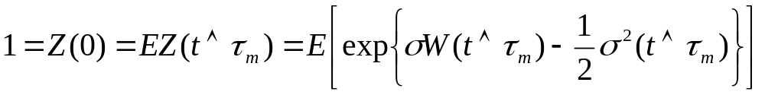

first passage time
Let m be a real number, and define the first passage time to level m
τ_{m}=min{t≥0;W(t)=m}.
This is the first time the Brownian motion W reaches the level m.
If the Brownian motion never reaches the level m, we set τ_{m}=∞
A martingale that is stopped (“frozen”) at a stopping time is still a martingale and thus must have constant expectation. (more detail: Theorem 4.3.2 of Volume I)
Because of this fact,
where the notation denotes the minimum of t and τ_{m}

Slide 7
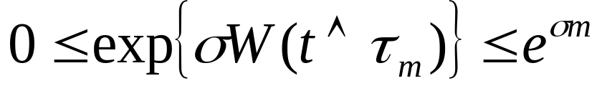
first passage time
We assume that σ>0 and m>0. In this case, the Brownian motion is always at or below level m for t ≤ τ_{m} and so

Slide 8
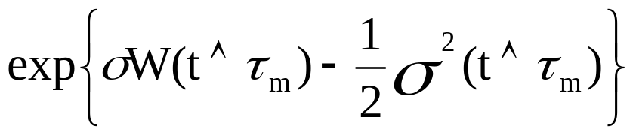
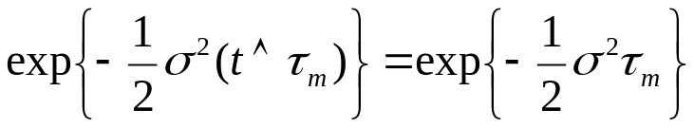
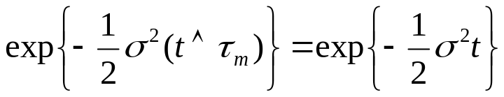
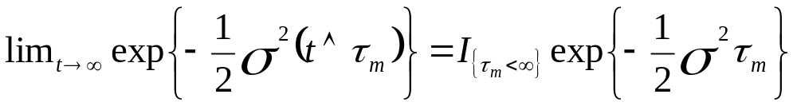
If τ_{m} <∞, the term
If τ_{m} =∞, the term
and as t→ ∞, this converge to zero.
We capture these two cases by writing

Slide 9
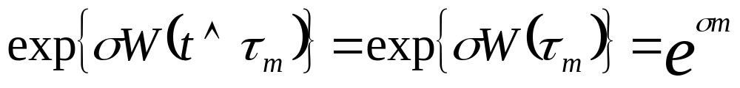

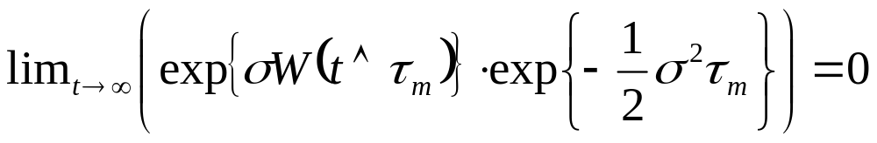
If τ_{m} <∞, then
where t becomes large enough.
If τ_{m} =∞, then we do not know what happens to
as t→∞, but we as least know that this term is bounded because of
That is enough to ensure that

Slide 10
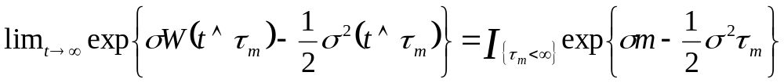
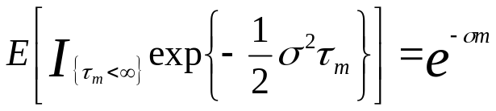
first passage time
In conclusion, we have
We take limit
and obtain (interchange of limit and expectation, by the Dominated Convergence Theorem, Theorem 1.4.9)
or, equivalently,
hold when m and σ are positive.

Slide 11

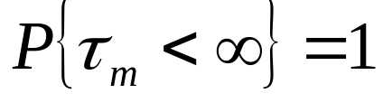
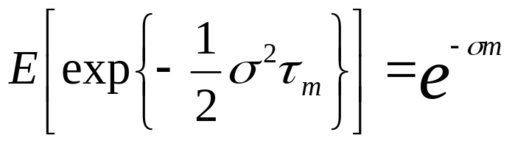
first passage time
Since it holds for every positive σ, we man take the limit on both sides as σ↓0.
This yields (use the Monotone Convergence Theorem, Theorem 1.4.5) or, equivalently,
Because τ_{m} is finite with probability one(almost surely), we may drop the indicator of this event
and obtain

Slide 12

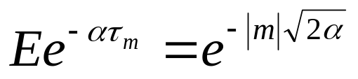
Theorem 3.6.2
For , the first passage time of Brownian motion to level m is finite almost surely, and the Laplace transform of its distribution is given by for all α>0

Slide 13
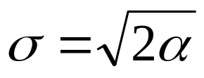
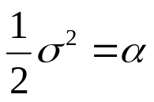
Proof of Theorem 3.6.2
(3.6.8)
When m is positive. Set , so that
If m is negative, then because Brownian motion is symmetric, the first passage times τ_{m} and τ_{|m|} have same distribution.
Equation
for all α>0
for negative m follows.

Slide 14
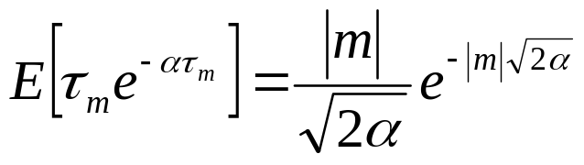

Remark 3.6.3
Differentiation of
for all α>0
with respect to α results in
for all α>0.
Letting α↓0, we obtain so long as m≠0

